Slide 1


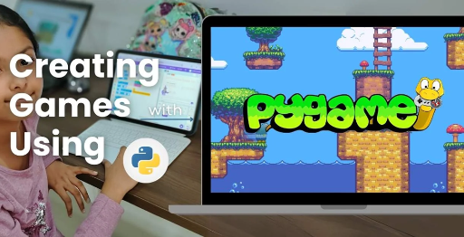
Session 12
Final Game Polish & Export Stepwise

Slide 2
Learning Objectives
Understand game inspiration, install Pygame-CE, navigate project structure
Detailed Objectives:
Objectives:
Polish the game with final menus, instructions, and visual enhancements.
Test the complete game for bugs and performance.
Package the project for submission or sharing.
GITHUB FINAL COMPLETE CODE REPOSITORY:
https://shorturl.at/5iWe9

Slide 3
Practical Tasks
Understand game inspiration, install Pygame-CE, navigate project structure
Below is the list of Practical Tasks:
Add an instructions screen in game_screens.py explaining game rules.
Refine visuals (e.g., button styles, text alignment) and fix any bugs.
Run a full test of both game modes, ensuring all mechanics (launching, collisions, power-ups, scoring) work.
Create a README.md with running instructions (similar to the input’s Section 4).
Zip the FeatherFall/ directory for submission.
GITHUB FINAL COMPLETE CODE REPOSITORY:
https://shorturl.at/5iWe9

Slide 4
Deliverables
Understand game inspiration, install Pygame-CE, navigate project structure
Session Deliverables:
A polished game with instructions and refined visuals.
A zipped project folder with a README.md.
A 5-minute class presentation showcasing the game.
Tips:
Playtest with a friend to catch bugs you might miss.
Practice your presentation to confidently show off your game!

Slide 5
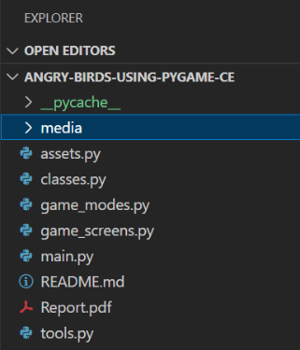
Game Polish & Export Workflow in PyGame
🧩 Game Polish & Export Workflow in PyGame
👉 Final step-by-step training to polish, package, and proudly present your OMOGAME project. CODE SNIPPET :
GITHUB FINAL COMPLETE CODE REPOSITORY:
https://shorturl.at/5iWe9

Slide 6
“Final Touches & Game Packaging”
🎨 “Final Touches & Game Packaging”
📂 “Make your game shine, bug-free, and ready for submission!” 🧠 Introduce the final phase of development: UI polish, testing, and project packaging.
Final phase for OMOTEC-PyGame: Siege of Avaria!
Inspired by Angry Birds, a two-player strategic battle game.
Focus: Polish UI, test thoroughly, and package for submission.
Use Pygame-CE to ensure a professional, engaging experience.
Prepare for a standout class presentation.

Slide 7
What Does Game Polish Mean?
🎨 What Does Game Polish Mean?
Visual Refinement 🖌️ (e.g., spacing, alignment, colors)
Consistent Menus & Navigation 🎮
Bug Fixes 🐞
Clean file structure 📂
README + ZIP for sharing 📦
🧠 This is your game’s final impression—make it count!
Visual Refinement: Align text, buttons, and power-up icons.
Consistent Navigation: Smooth menu and screen transitions.
Bug Fixes: Eliminate crashes or gameplay errors.
Clean Structure: Organized files for easy sharing.
README + ZIP: Clear instructions for running the game.
Creates a lasting impression for players and evaluators.

Slide 8
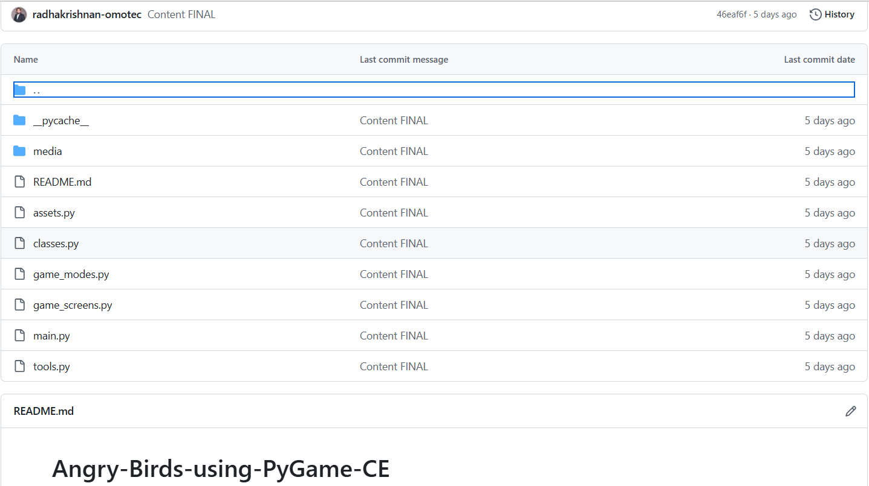
What Does Game Polish Mean?
🧩 Game Polish & Export Workflow in PyGame CODE SNIPPET :

Slide 9
Add Instruction & Credits Screens
🎨 Add Instruction & Credits Screens
📘 In game_screens.py, create:
“How to Play” instructions
Game mode details (Quick vs Basic)
Author name, team role, credits
💡 Use buttons to navigate from menu → instruction → game
In game_screens.py:
“How to Play” screen with gameplay basics.
Details for Quick (200 points) and Basic (power-ups) modes.
Credits: Author names, team roles, and asset sources.
Add navigation buttons: Menu → Instructions → Game.
Use assets.py for fonts and images from media/.
Enhances user understanding and professionalism.

Slide 10
Refine Visual Layouts
🎨 Refine Visual Layouts
Check for:
🎯 Centered text and buttons
✅ Consistent fonts and sizes
🎨 Aligned power-up icons
🧱 No overlapping elements
📌 Use pygame.draw.rect() and padding values to tidy up layouts
Refine Visual Layouts
Ensure:
Centered text and buttons for clean UI.
Consistent fonts/sizes via assets.py (e.g., sci-fi.ttf).
Aligned power-up icons from media/icons/.
No overlapping elements in game_screens.py.
Use pygame.draw.rect() with padding for tidy layouts.
Test visuals in both Quick and Basic modes.

Slide 11
Final Gameplay Testing Checklist
🎨 Final Gameplay Testing Checklist
🔄 Run full tests for:
Bird Launching
Block Destruction
Alien Collisions
Power-Up Activation
Score Display
Turn Switching
Game Over Detection
💬 Use print logs: print("Collision detected") to trace issues
Final Gameplay Testing Checklist
Test key mechanics in main.py and game_modes.py:
Bird launching (physics in classes.py).
Block destruction (collisions in tools.py).
Alien collisions (bonus points in game_modes.py).
Power-up activation in Basic Mode.
Score display and turn switching.
Game-over detection in game_screens.py.
Debug with: print("Collision detected") in tools.py.

Slide 12
Create a README.md File
🎨 Create a README.md File CODE SNIPPET :
📄 Content:
# OMOGAME – Siege of Avaria!
## How to Run:
## Game Modes:
## Author:
README.md content:
# OMOTEC-PyGame: Siege of Avaria!
## How to Run:
1. Install Python from https://www.python.org/downloads/
2. Run `pip install pygame`
3. Execute `python main.py`
## Game Modes:
- Quick: First to 200 points by hitting blocks/aliens.
- Basic: Destroy opponent’s structure with power-ups.
## Author:
Team [YourTeamName]
Include a gameplay screenshot for visual appeal.
Store in project root for clarity.

Slide 13
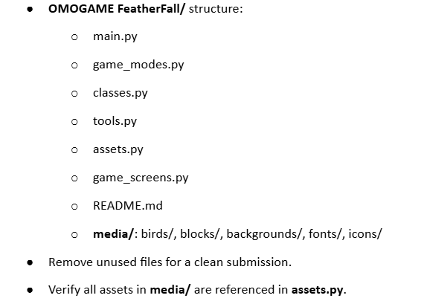
Organize Your OMOGAME Project Folder
🎨 Organize Your Project Folder
👉Folder structure to submit:
OMOGAME FeatherFall/
│ main.py
│ game_modes.py
│ classes.py
│ tools.py
│ assets.py
│ game_screens.py
│ README.md
├── media/
│ ├── birds/
│ ├── blocks/
│ ├── backgrounds/
🧹 Remove unused files to keep it clean

Slide 14
“Final Touches & Game Packaging”
🎨 Zip and Submit
🗂️ Use:
Right-click → Compress to ZIP (Windows/Mac)
Online zip tools if needed ✅ Ensure ZIP contains:
All .py files
media folder
README.md
📦 Final file: OMOGAME_TeamName.zip
Create ZIP:
Right-click FeatherFall/ → Compress to ZIP.
Or use online tools for zipping.
Ensure ZIP includes:
All .py files (main.py, game_modes.py, etc.).
media/ folder with all assets.
README.md with instructions.
Name file: OMOGAME_TeamName.zip.
Test unzip to confirm all files are included.

Slide 15
Class Presentation Tips:
🎨 Class Presentation Tips
🎤 In 5 minutes, show:
The problem your game solves (fun strategy)
Key mechanics (launching, scoring, power-ups)
One exciting moment (alien hit, power-up use)
Screenshots or a live demo 👉 Practice with a friend or mirror!
In 5-minute presentation:
Explain game’s purpose: Fun, strategic two-player battles.
Highlight mechanics: Bird launching, scoring, power-ups.
Showcase exciting moment (e.g., alien hit, power-up effect).
Share screenshots or run a live demo.
Practice with a friend or mirror for confidence.
Use game_screens.py visuals for engaging slides.

Slide 16
Final Recap – From Code to Completion
🎨 Final Recap – From Code to Completion
✔ What you completed:
UI polish + bug testing
Instruction + credit screens
Final packaging
README.md
Class-ready presentation
👉 You built a fully working game from scratch—be proud and hit export!
Achievements:
Polished UI with consistent layouts and navigation.
Thoroughly tested gameplay mechanics and bug fixes.
Added instruction and credits screens in game_screens.py.
Packaged project with README.md and ZIP.
Prepared a compelling class presentation.
Tip: Test edge cases (e.g., simultaneous wins) before submission.

Slide 17

Exercise:
1. What is the primary objective of the Quick Mode in OMOGAME?
A) Collect all power-ups before the opponent
B) Launch birds without any destruction
C) Reach a score of 200 points
D) Complete the entire storyline
Answer: C) Reach a score of 200 points
2. Which file is considered the main entry point of the OMOGAME project? A) tools.py
B) main.py
C) assets.py
D) classes.py
Answer: B) main.py

Slide 18
Exercise..
3. What does the tools.py file mainly handle in the game?
A) Launching sound and animation
B) Player avatar selection
C) Collision detection and drawing functions
D) Managing game instructions
Answer: C) Collision detection and drawing functions
4. Which of the following is NOT listed as a unique feature of OMOGAME? A) Bird classes with special physics
B) Alien targets for bonus points
C) Multiplayer online matchmaking
D) Destructible block environments
Answer: C) Multiplayer online matchmaking

Slide 19
Exercise…
5. Why is organizing the OMOGAME project into files like classes.py, media/, and game_modes.py important?
A) It reduces the game’s memory usage
B) It helps reduce the number of bugs completely
C) It makes the project look colorful
D) It simplifies managing and updating different game parts
Answer: D) It simplifies managing and updating different game parts

Slide 20
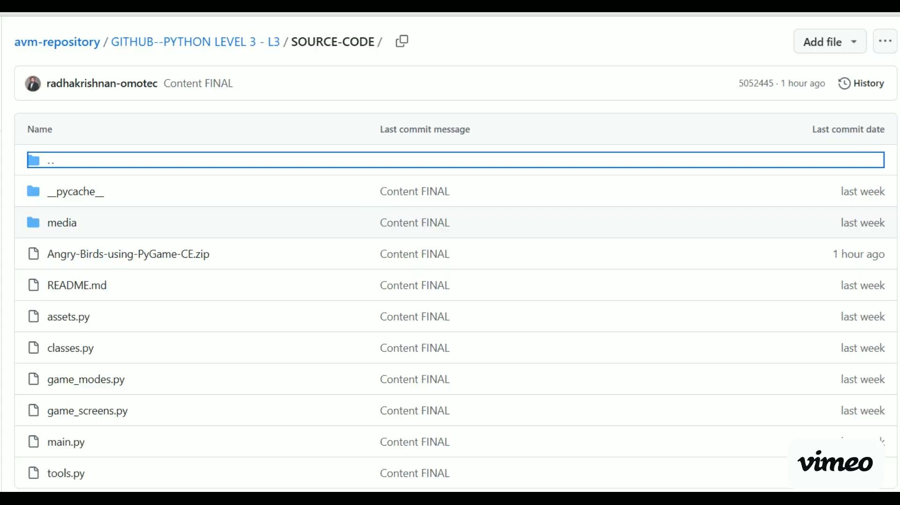
Session 12 VIDEO LINK
Final Game Polish & Export Stepwise

